Slide 1

User Insights Analyst - Case Study
Chetan Sonar

Slide 2

Introduction
This case study focuses on analyzing user behavior and deriving actionable insights to improve retention, enhance marketing strategies, and refine onboarding processes for the FOOD app.
FOOD is a platform designed for travelers to discover personalized restaurant recommendations. It operates on both web and app platforms, with a focus on user engagement and seamless experience.
Objectives:
Understand and analyze user retention trends to propose improvements.
Evaluate the effectiveness of various acquisition channels based on revenue metrics.
Identify optimal strategies to encourage first-time users to return and make additional transactions.
Provide recommendations for a streamlined and effective onboarding flow with key event tracking.

Slide 3
Glossary
Terminologies | Explanation
Cohorts | A group of users with shared characteristics or experiences during the same time period.
ARPU (Average Revenue Per User) | The average revenue generated per user over a specific time.
Outliers | Data points that are significantly different from the rest of the dataset.

Slide 4
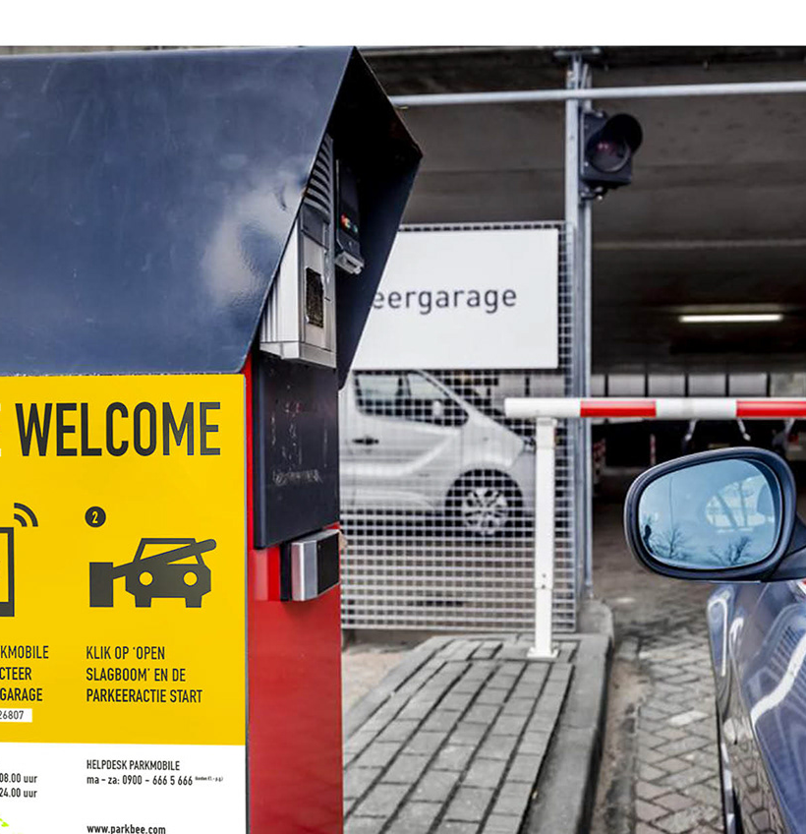
Part 1: Data Analysis
1. The product manager has come to you wanting to better understand how effectively FOOD is retaining its users. Can you calculate user retention rates and identify any trends or patterns? Based on your insights, what recommendations would you make to improve retention?

Slide 5
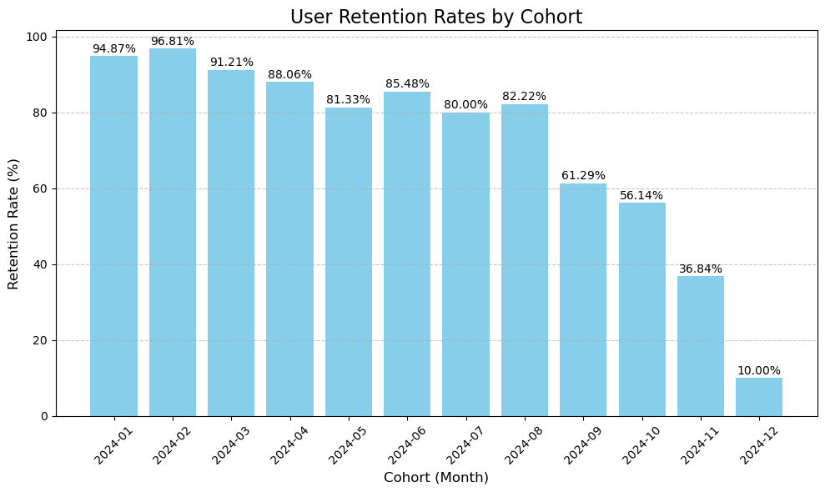
Analyzing User Retention Trends: Insights by Cohort

Slide 6
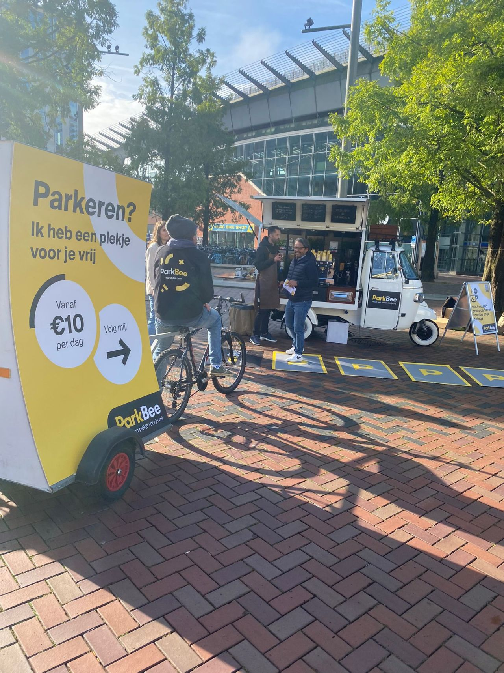
Insights
1. High Initial Retention:
Earlier (January to March 2024) show retention rates above 90%, indicating strong engagement and successful onboarding strategies during that period.
2. Gradual Decline:
Starting from May 2024, retention begins to decline steadily, with cohorts from September to December showing significant drops (December cohort at 10%).
3. Seasonality:
Seasonality: User engagement might vary by time of year, with certain months (holiday season) seeing less frequent app usage.
4. Possible Factors for Decline:
Newer Users: Newer cohorts may face onboarding issues, lack of clarity in app value proposition, or less personalized engagement strategies.
5. Patterns:
Consistency in earlier cohorts suggests onboarding effectiveness and satisfaction during that time.
Later declines could indicate the need for revisiting user acquisition and early engagement strategies.

Slide 7
Recommendation
1. Improve Onboarding:
Ensure users understand the platform’s value proposition during onboarding to increase the likelihood of repeat transactions.
2. Engage Early:
Re-engage users soon after their first transaction (within 7 days) with personalized offers or content.
3. Focus on High-Retention Cohorts:
Identify cohorts with above-average retention and replicate their acquisition and engagement strategies for new users.
4. Incentivize Repeat User:
Offer loyalty rewards or discounts for users who make multiple purchases.
5. Segmented Retention Campaigns:
Use targeted campaigns based on user preferences (cuisine types, budget) to encourage repeat transactions.
6. Engagement Strategies:
Investigate user engagement strategies for earlier cohorts to replicate success for later cohorts.
Focus on re-engagement campaigns for users acquired in later months with lower retention (October to December).

Slide 8
Part 1: Data Analysis
2. The marketing manager needs to understand what channels are most effective in acquiring users. Can you determine the most effective channels based on average revenue per user? Based on your insights, what recommendations would you make to the marketing manager?

Slide 9
Channel Performance Analysis: Identifying Revenue Drivers
Acquisition Channel | Revenue | Total Users | ARPU
Google Ads | 26911.38 | 348 | 77.33
Referral | 26307.95 | 358 | 73.49
Facebook Ads | 26982.82 | 368 | 73.32
Organic Search | 25780.98 | 368 | 70.06
Email Campaign | 25199.05 | 368 | 68.48

Slide 10
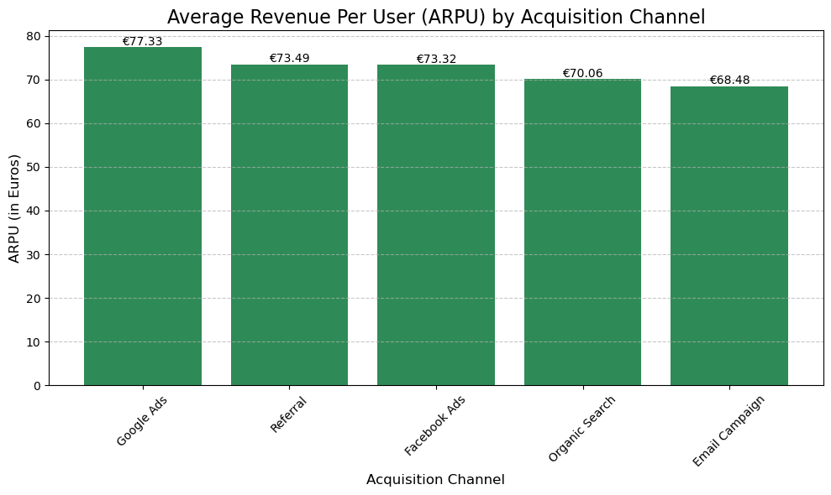
Channel Performance Analysis: Identifying Revenue Drivers

Slide 11
Insights
Google Ads is the most effective channel, generating the highest ARPU. It indicates that users acquired through this channel are more likely to spend more on the platform.
Referral and Facebook Ads channels also perform well, with comparable ARPU values, making them valuable for acquiring high-revenue users.
Organic Search and Email Campaigns lag slightly behind but could still be effective depending on their cost of acquisition.

Slide 12
Recommendations
Investment in Google Ads:
Increase the budget allocated to Google Ads campaigns as they bring in the highest-revenue users.
Optimize keywords and audience targeting to maintain and enhance performance.
Referral Programs:
Referral channels drive high ARPU users. Introduce additional incentives (example, discounts, rewards) to increase participation.
Leverage satisfied customers to encourage peer recommendations.
Facebook Ads Campaigns:
Improve ad creatives, experiment with retargeting strategies, and focus on lookalike audiences to maximize returns.
Reevaluate Organic Search and Email Campaigns:
Organic Search: Optimize SEO to increase traffic and potentially target higher-value segments.
Email Campaigns: Experiment with personalization, better segmentation, and content improvements to boost ARPU.

Slide 13
Part 1: Data Analysis
3. The team wants to encourage first time users to return and make a second transaction. Looking at the time between first and second purchases, can you identify the optimal time to re-engage with these users? What strategies would you recommend to effectively reach out to these users?

Slide 14
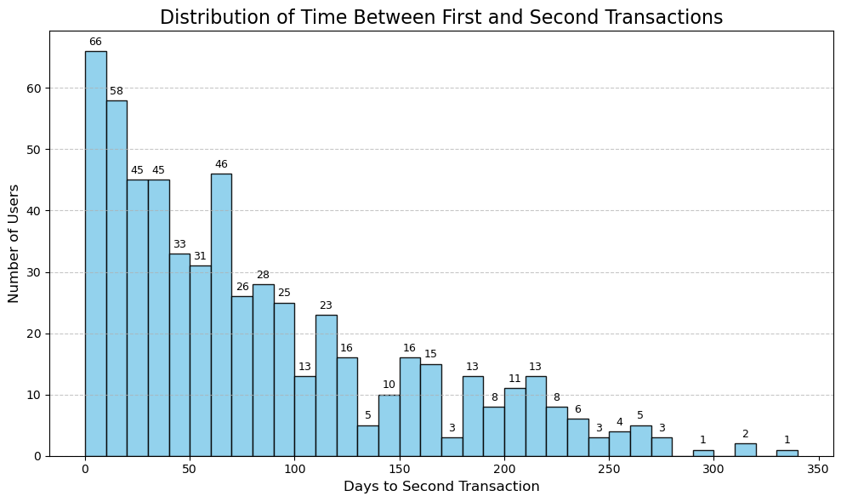
Optimal Time to Re-Engage First-Time Users
Short-Term (0–30 days): The highest number of users return within the first 30 days, with a peak at around 18 days. This is the best period to target most users with reminders and incentives to complete a second transaction.
Mid-Term (30–90 days): A good number of users return between 30 and 90 days, making this the second priority window. Users in this range might require more personalized or enticing offers.
Long-Term (90+ days): After 90 days, user returns reduces significantly.

Slide 15
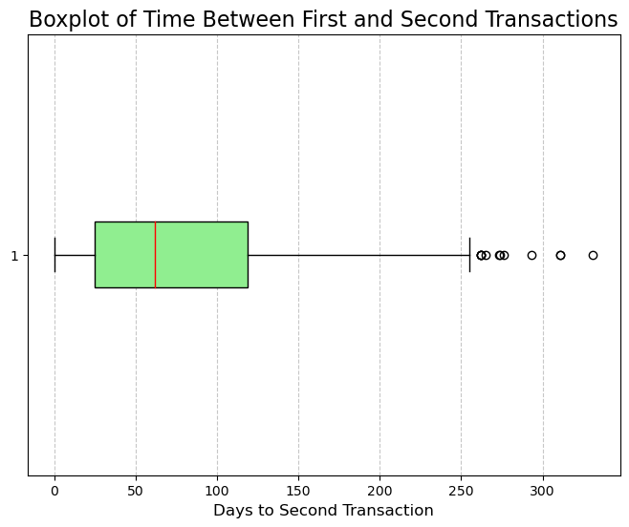
Overview of Time Distribution
The majority of users fall within the first 100 days.
Some users take significantly longer (outliers) to return, up to almost a year.

Slide 16
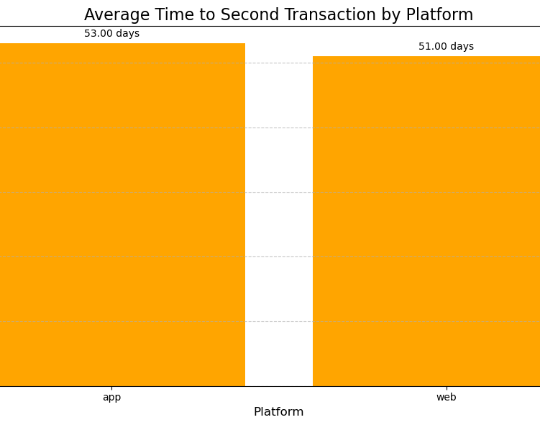
Platforms
App users may engage more frequently due to push notifications and easier access.
Web users might require email campaigns or targeted ads for re-engagement.

Slide 17
Recommendations for Re-Engagement Strategies
For the First 30 Days:
Send personalized thank-you messages shortly after the first purchase.
Highlight products related to their previous purchase to encourage repeat buying.
Create urgency by offering time-limited deals or promotions.
For 30 to 90 Days:
Showcase products or services they may have missed since their last visit.
Use friendly reminders to stay on their radar and encourage them to return.
Offer appealing incentives, such as free shipping or loyalty rewards, to motivate them.
After 90 Days:
Launch a campaign designed to re-engage inactive users with attractive offers.
Remind users of the value or benefits they experienced previously.
Share updates about new features, products, or improvements to spark renewed interest.

Slide 18
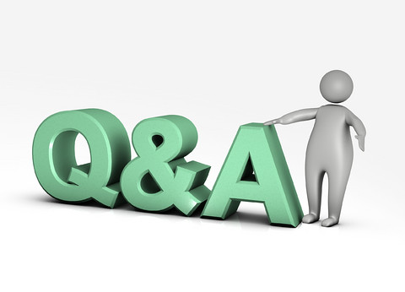

Thank you for your attention!

